Slide 1
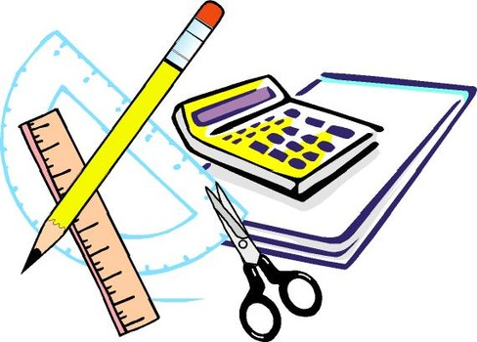
Learning Objective
I will calculate probabilities from two way tables.
Enter quietly, please be ready with the following on your desk:
Whiteboard
Whiteboard marker
Exercise Book
Pencil, pen, ruler and red pen
Diary
Calculator
Device – charged or borrowed from Library before maths

Slide 2
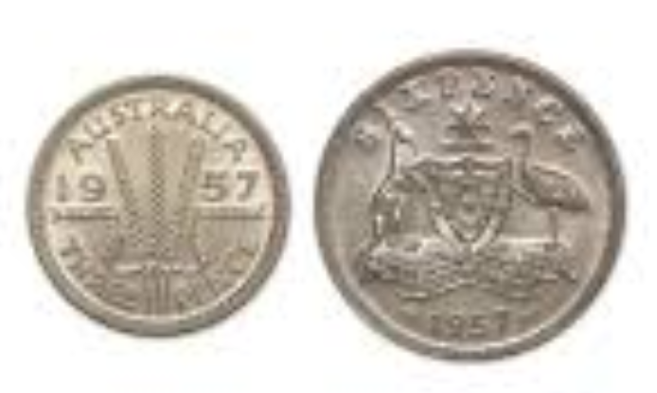
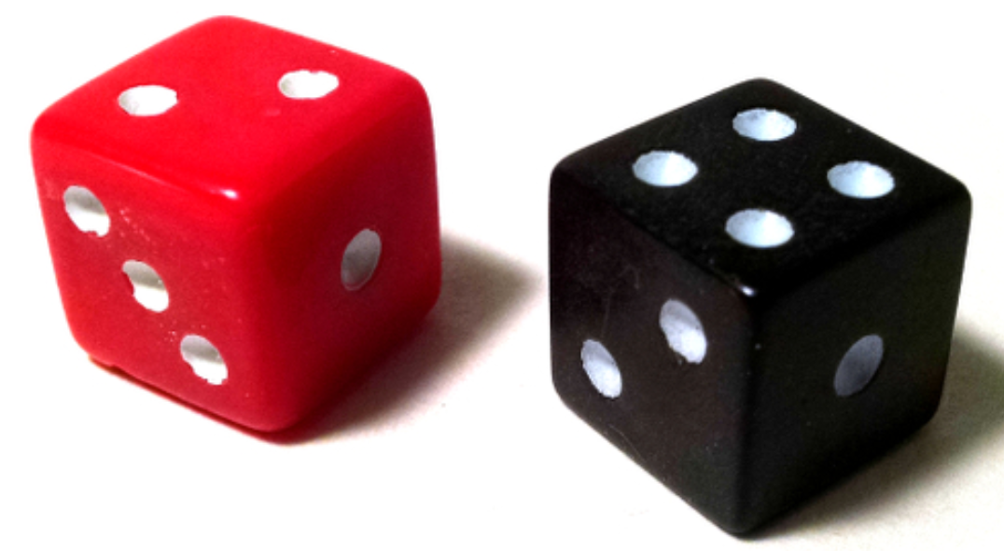
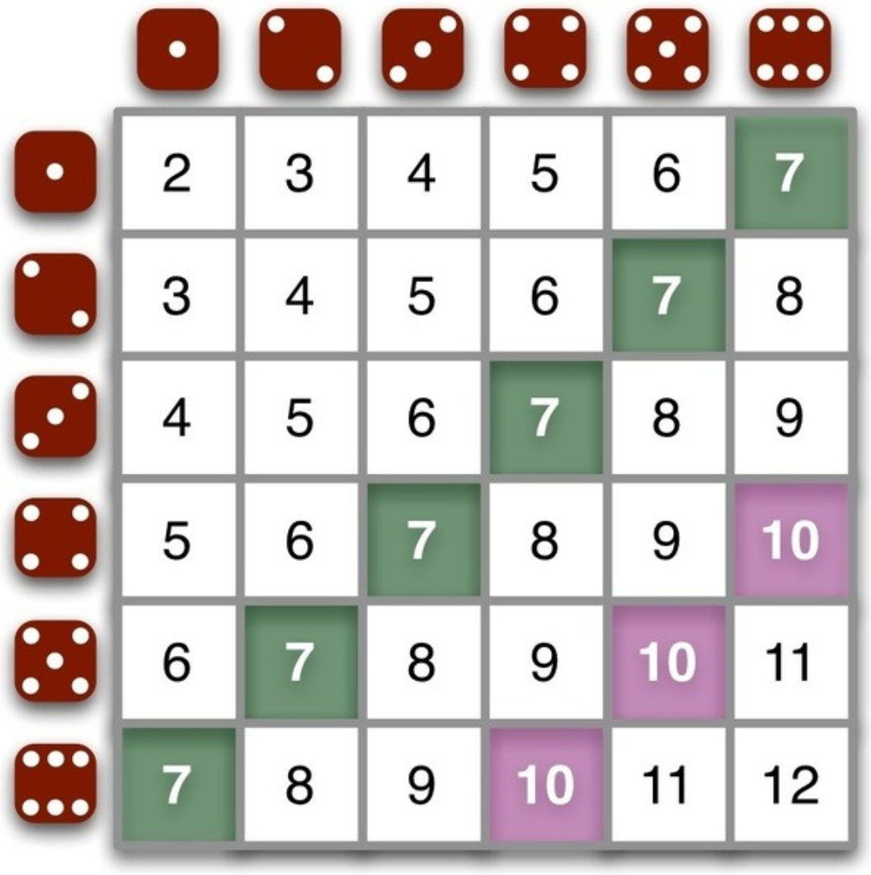
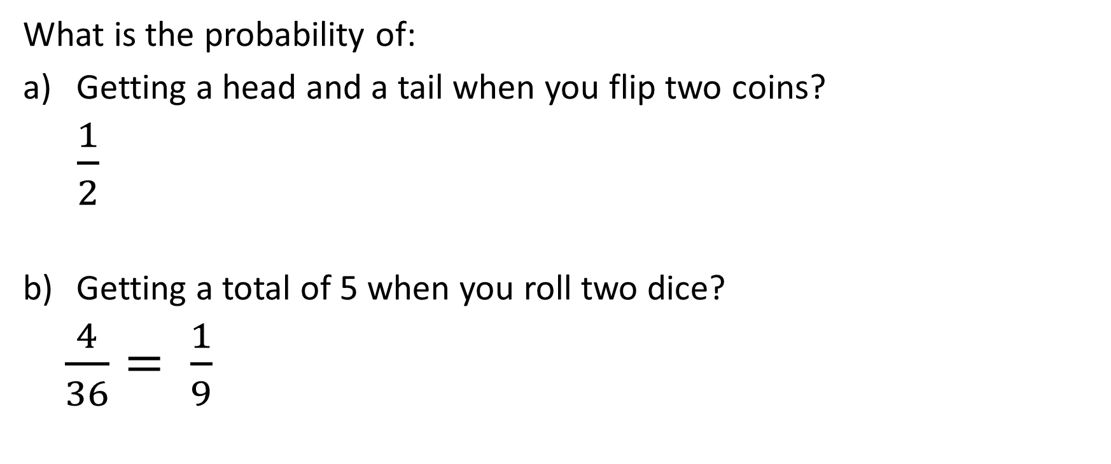
Daily Review
H H
T T
H T
T H
What is the probability of:
Getting a head and a tail when you flip two coins?
$\frac{1}{2}$
Getting a total of 5 when you roll two dice?
$\frac{4}{36}= \frac{1}{9}$

Slide 3
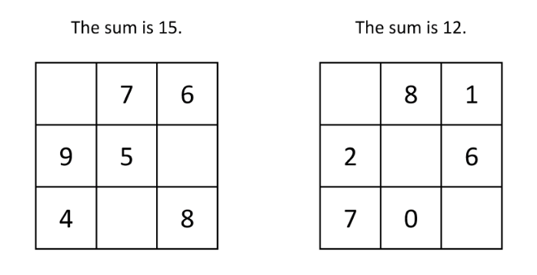
Daily Review
Fill in the magic square puzzles.

Slide 4
Daily Review
How many boys in Year 8?
How many girls in Year 7?
How many boys in Year 7 and 8?
How many girls in total?
How many Year 9s in total?
How many students in total?
15
16
14 + 15 = 29
16 + 13 + 10 = 39
18 + 10 = 28
86
 | Year 7 | Year 8 | Year 9
Boys | 14 | 15 | 18
Girls | 16 | 13 | 10
15
11
0 + 14 = 14
15 + 15 + 9 = 39
11 + 15 = 26
64
How many girls in Year 8?
How many boys in Year 7?
How many boys in Year 8 and 9?
How many girls in total?
How many Year 7s in total?
How many students in total?
 | Year 7 | Year 8 | Year 9
Boys | 11 | 0 | 14
Girls | 15 | 15 | 9

Slide 5
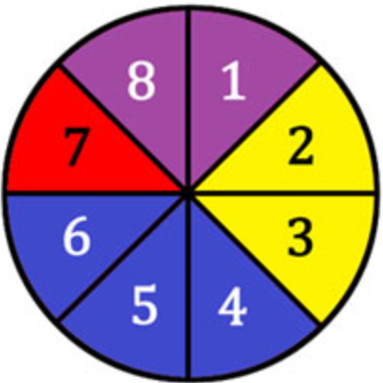
Learning Objective
CFU 1
What will we learn?
I will calculate probabilities from two way tables.
CFU 2
What will we learn?
Success Criteria
I will be able to list sample spaces.
I will be able to calculate probabilities of single events.
I will be able to interpret two way tables.

Slide 6
Activate Prior Knowledge
 | Year 7 | Year 8 | Year 9 | TOTAL
Boys |  |  | 11
Girls | 10 |  |  | 43
TOTAL |  | 31 | 25 | 85
19
12
42
19
14
29

Slide 7
Concept Development
CFU 1
Why isn’t people a category?
We can easily create our own two-way tables.
90 people were asked whether they preferred Soaps, Drama or Crime shows.
12 men said they liked Dramas.
33 people in total said they liked Soaps, and 27 of these were women.
25 people in total liked Dramas best.
Only 10 women liked Crime shows.
Find the CATEGORIES.
Create your TABLE.
 | S | D | C | TOTAL
M
W
TOTAL

Slide 8
Skill Development
CFU 1
How many people were there in total?
In a supermarket survey, 30 men and 30 women were asked whether they preferred orange juice or grapefruit juice. 22 men preferred orange juice. 12 women preferred grapefruit juice.
A
B
 | Grapefruit Juice | Orange Juice
Men | 12 | 22
Women | 18 | 8
 | Grapefruit Juice | Orange Juice
Men | 13 | 22
Women | 12 | 9
C
 | Grapefruit Juice | Orange Juice
Men | 8 | 22
Women | 12 | 18
D
 | Grapefruit Juice | Orange Juice
Men | 8 | 12
Women | 22 | 8

Slide 9



Skill Development
 | Year 7 | Year 8 | Year 9 | TOTAL
Boys | 9 | 8 | 12 | 29
Girls | 4 | 10 | 7 | 21
TOTAL | 13 | 18 | 19 | 50
If I was to choose a pupil at random, what is the probability of selecting a Year 8 pupil?
Pr(Year 8) =
What is the probability that a pupil selected at random will be a boy?
Pr(boy) =
If a Year 7 pupil is selected, what is the probability that they are a girl?
Pr(girl if Year 7) =
$$\frac{18}{50}=\frac{9}{25}$$
 | Year 7 | Year 8 | Year 9 | TOTAL
Boys | 9 | 8 | 12 | 29
Girls | 4 | 10 | 7 | 21
TOTAL | 13 | 18 | 19 | 50
$$\frac{29}{50}$$
 | Year 7 | Year 8 | Year 9 | TOTAL
Boys | 9 | 8 | 12 | 29
Girls | 4 | 10 | 7 | 21
TOTAL | 13 | 18 | 19 | 50
$$\frac{4}{13}$$

Slide 10
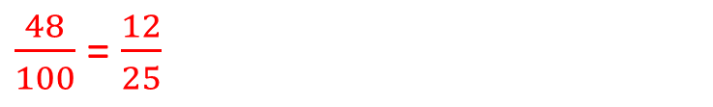
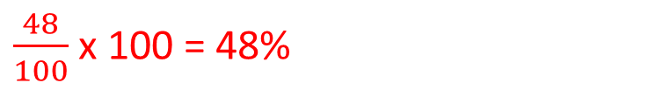
Guided Practice
Members of a gym were asked what kind of training they do.
Each responder only did one kind of training. The table shows the results.
 | Cardio | Weight
Male | 19 | 29
Female | 33 | 19
How many gym members were asked altogether?
19 + 29 + 33 + 19 = 100
How many members do weight training?
29 + 19 = 48
What percentage of members do weight training?
$\frac{48}{100}$ x 100 = 48%
What is the probability that a member selected at random does weight training?
$\frac{48}{100}$ = $\frac{12}{25}$

Slide 11
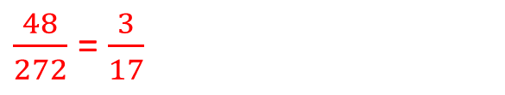
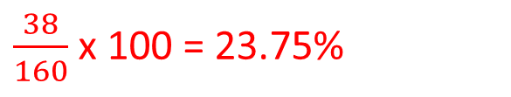
Guided Practice
The following table has been drawn up to show the results of a survey on smoking.
 | Smokers | Nonsmokers
Male | 48 | 64
Female | 38 | 122
How many people were surveyed?
48 + 64 + 38 + 122 = 272
How many females were surveyed?
38 + 122 = 160
How many of the people surveyed were smokers?
48 + 38 = 86
What percentage of females were nonsmokers?
$\frac{38}{160}$ x 100 = 23.75%
If a person is selected at random from the group, what is the probability that they are a male smoker?
$\frac{48}{272}$ = $\frac{3}{17}$

Slide 12
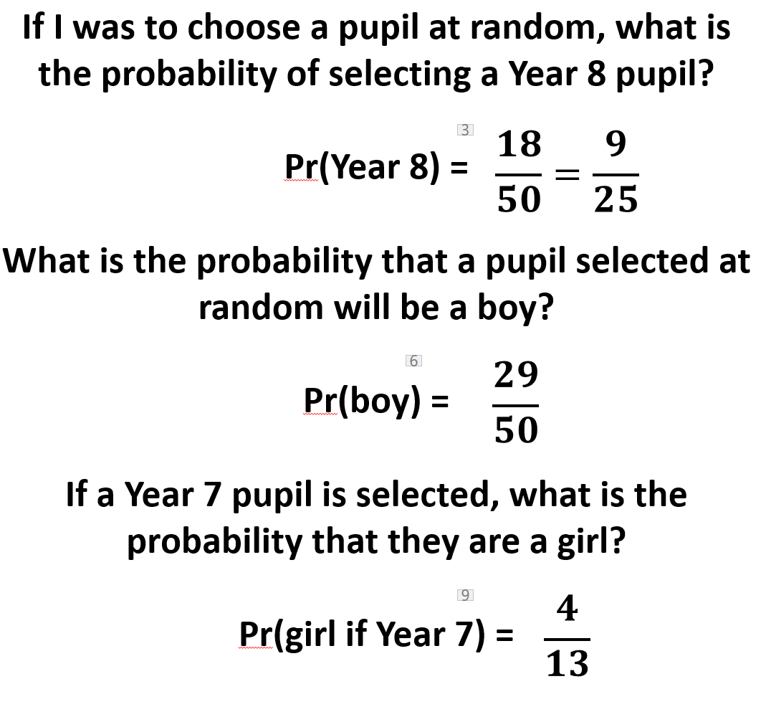
Skill Development
Independent Practice
Year 10 Mainstream Two Way Tables CLASS WORK
 | Year 7 | Year 8 | Year 9 | TOTAL
Boys | 9 | 8 | 12 | 29
Girls | 4 | 10 | 7 | 21
TOTAL | 13 | 18 | 19 | 50
 | Year 7 | Year 8 | Year 9 | TOTAL
Boys | 9 | 8 | 12 | 29
Girls | 4 | 10 | 7 | 21
TOTAL | 13 | 18 | 19 | 50
 | Year 7 | Year 8 | Year 9 | TOTAL
Boys | 9 | 8 | 12 | 29
Girls | 4 | 10 | 7 | 21
TOTAL | 13 | 18 | 19 | 50

